Slide 1


QmaK4TLaJgophrxaHBj4E45Ux5G2usgbdnSBWFmQuGqTzG MIAMI TOKEN

Slide 2
Miami Token
The Miami Token (MIA) was created in 2021 to offer smart contract solutions using a very creative reward program, using cryptos as the reward. Payment methods are changing, and our reward program will incentivize and educate people about this new technology.
Our solution is to enable a decentralized reward system that encourages spending and investment in local businesses. Miami Token will attract new customers and we will create more revenue to invest starting in small communities.

Slide 3
Cons of The Current Reward System
Rewards programs are often run at the discretion of the company providing them. If they decide to scrap the program for any reason, then consumers typically lose the points they’ve earned without any compensation. Sometimes a program may transition to a different kind of reward, which may lessen the value that consumers experience from their points.
Some programs offer point bonuses on specific purchases. Others offer no points unless certain purchases are made. The offers vary over time, so it is important for consumers to always be up-to-date regarding how they can earn points.
It encourages people to spend more money.

Slide 4
The MIA Highlights
The current reward system has gas fees of $3.00 per transaction on average. However, with our Miami Token Reward System, we are utilizing the Algorand ecosystem and blockchain technology to reduce transaction costs by an average of 60%.
The current reward system encourages consumers to spend more money, whereas with our reward system, we would encourage people to spend and invest because as they earn rewards, they could redeem for crypto and start participating in the crypto market.

Slide 5
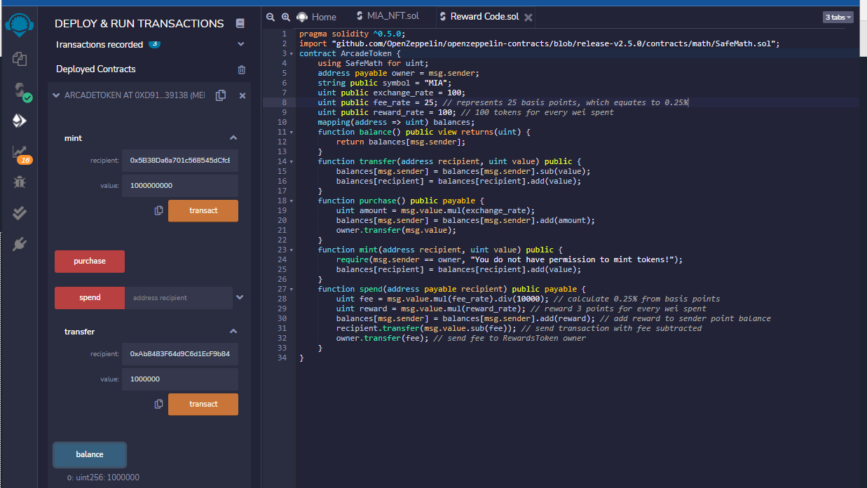
Miami Token Reward Code

Slide 6
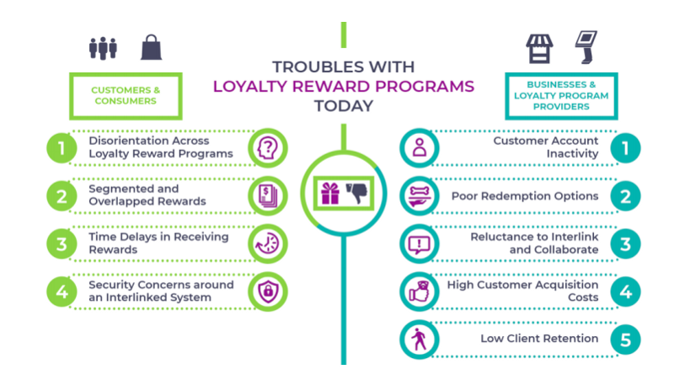
Summary of Pros & Cons

Slide 7
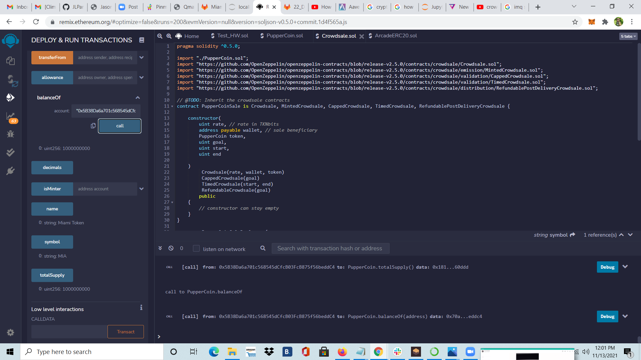
Miami Token Info

Slide 8

Crowdsale

Slide 9
Crowdsale
A cryptocurrency Crowdsale is a method of funding a project through the sale of digital tokens that give their buyer the right to participate in an idea being funded by the sale.

Slide 10
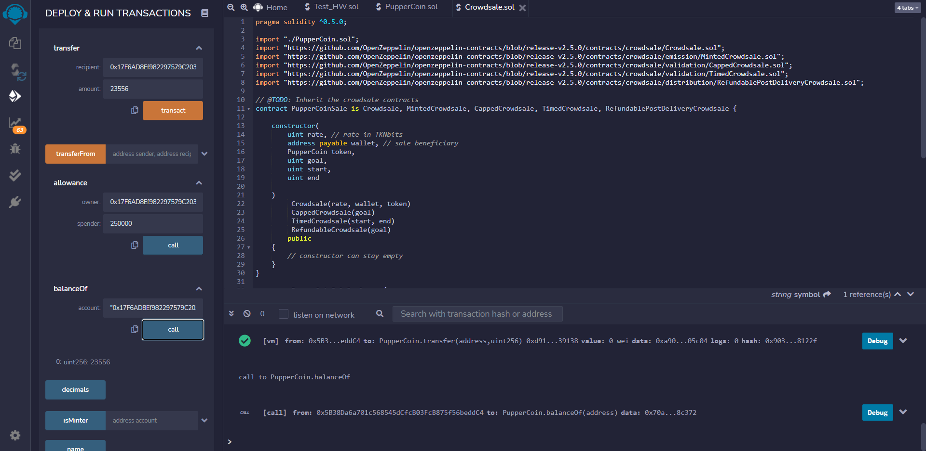
Crowdsale Solidity Code

Slide 11
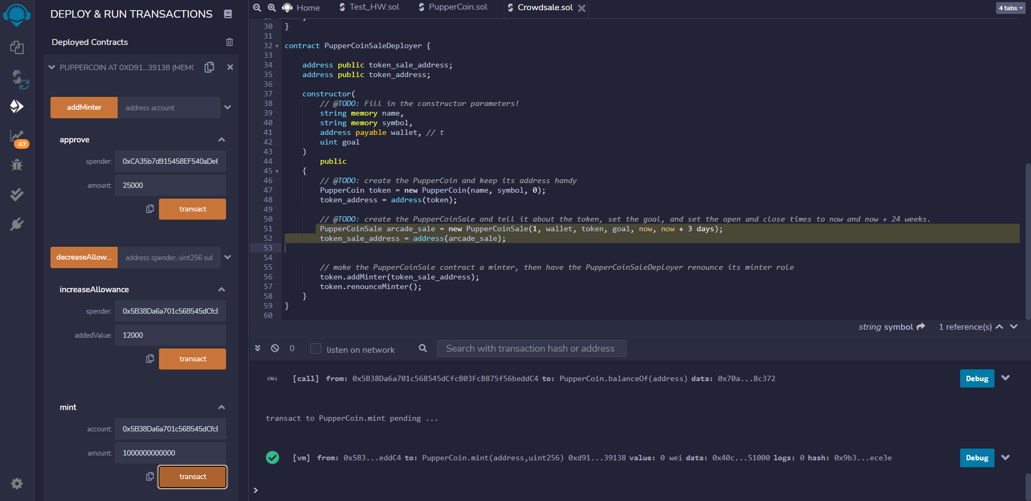
Crowdsale Countdown

Slide 12
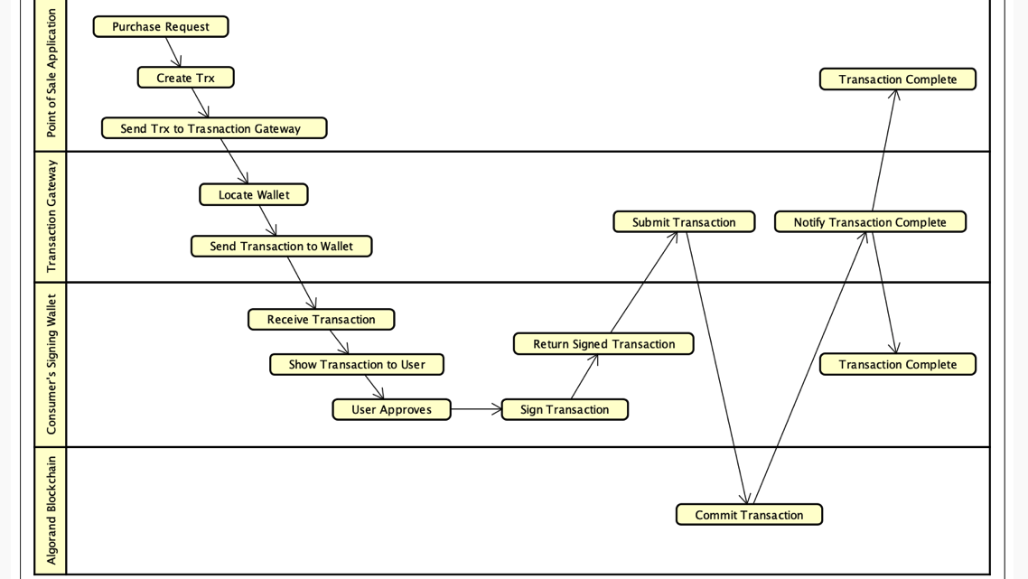
Transaction Flow

Slide 13
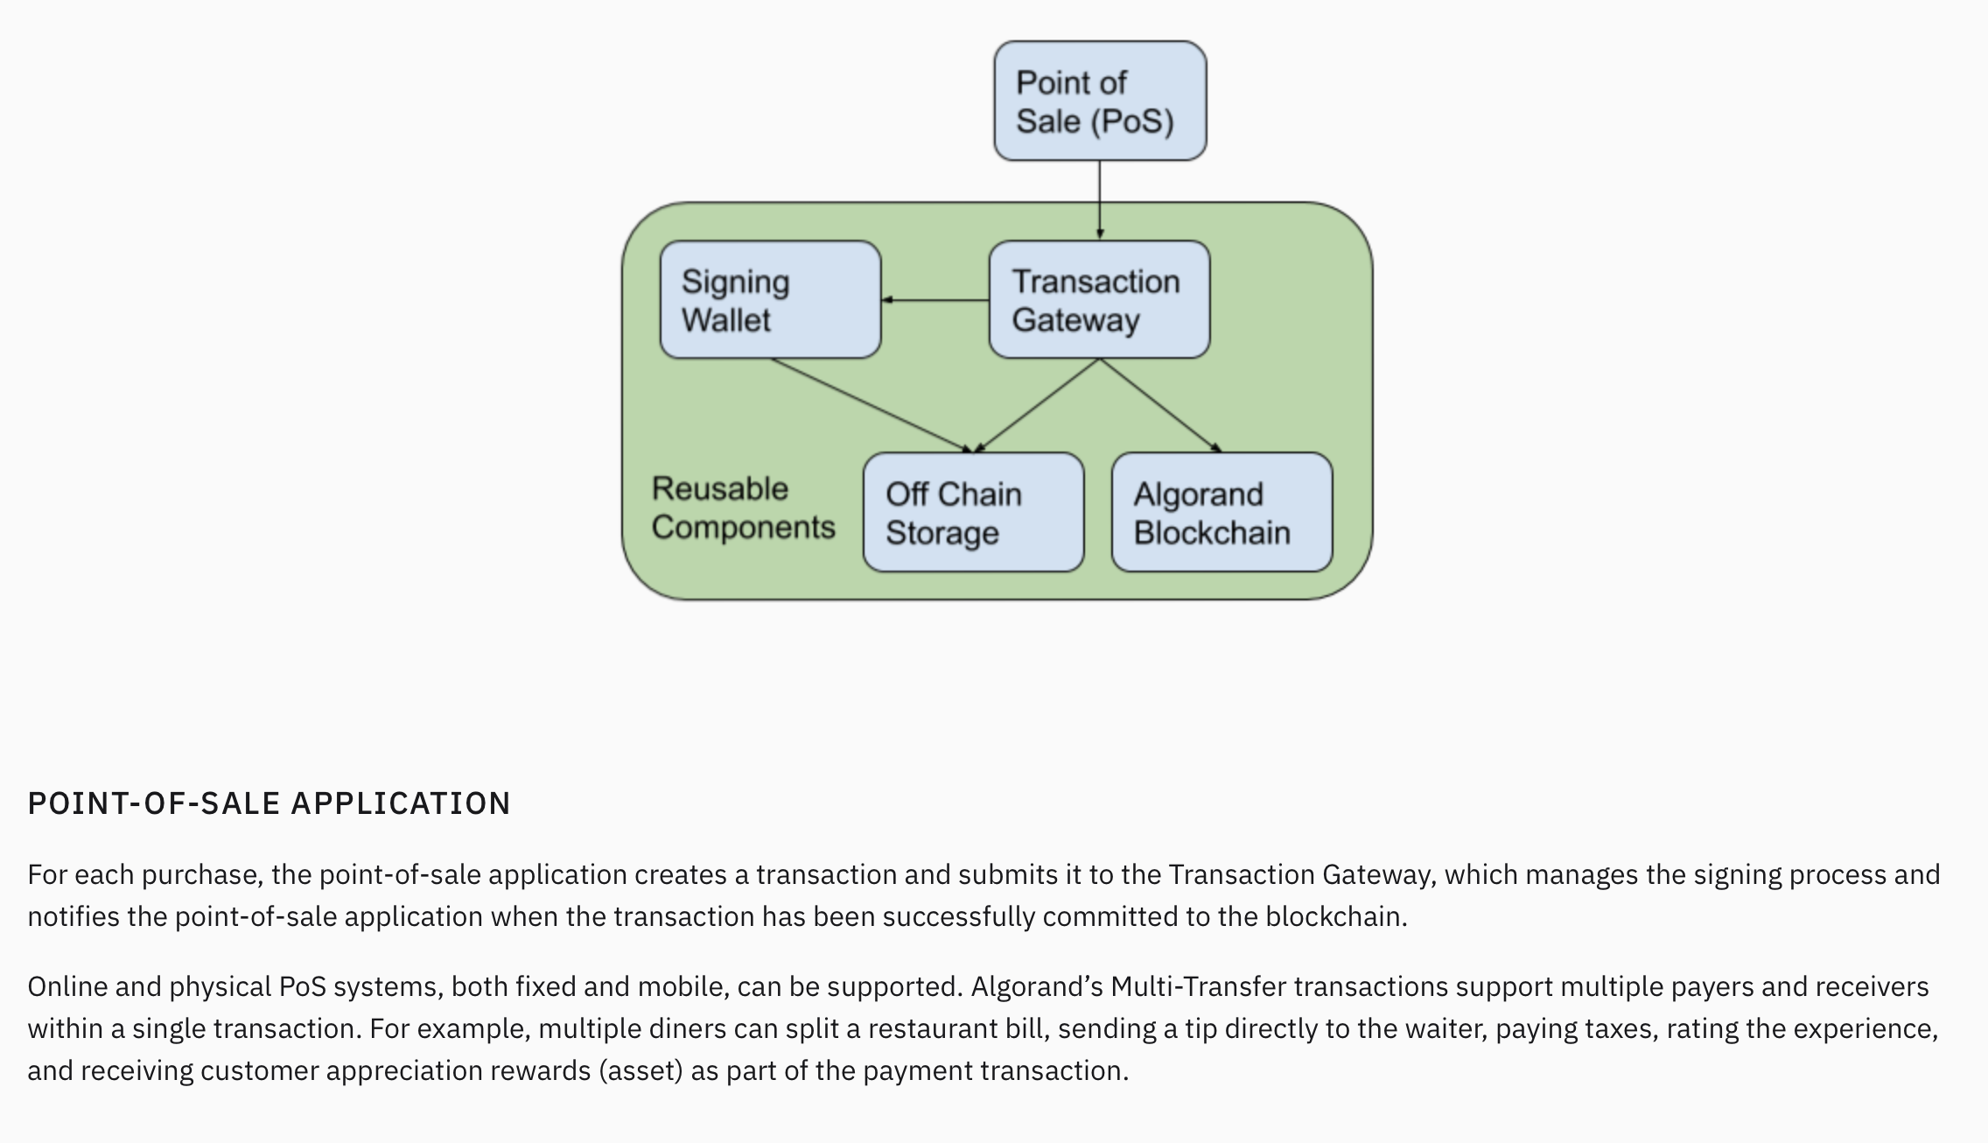
System
Algorand
Transaction

Slide 14
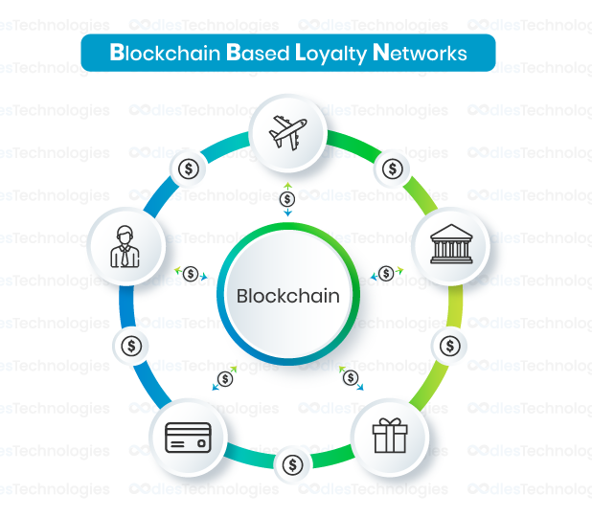
Miami Token Loyalty Network

Slide 15

Miami Token Benefits

Slide 16
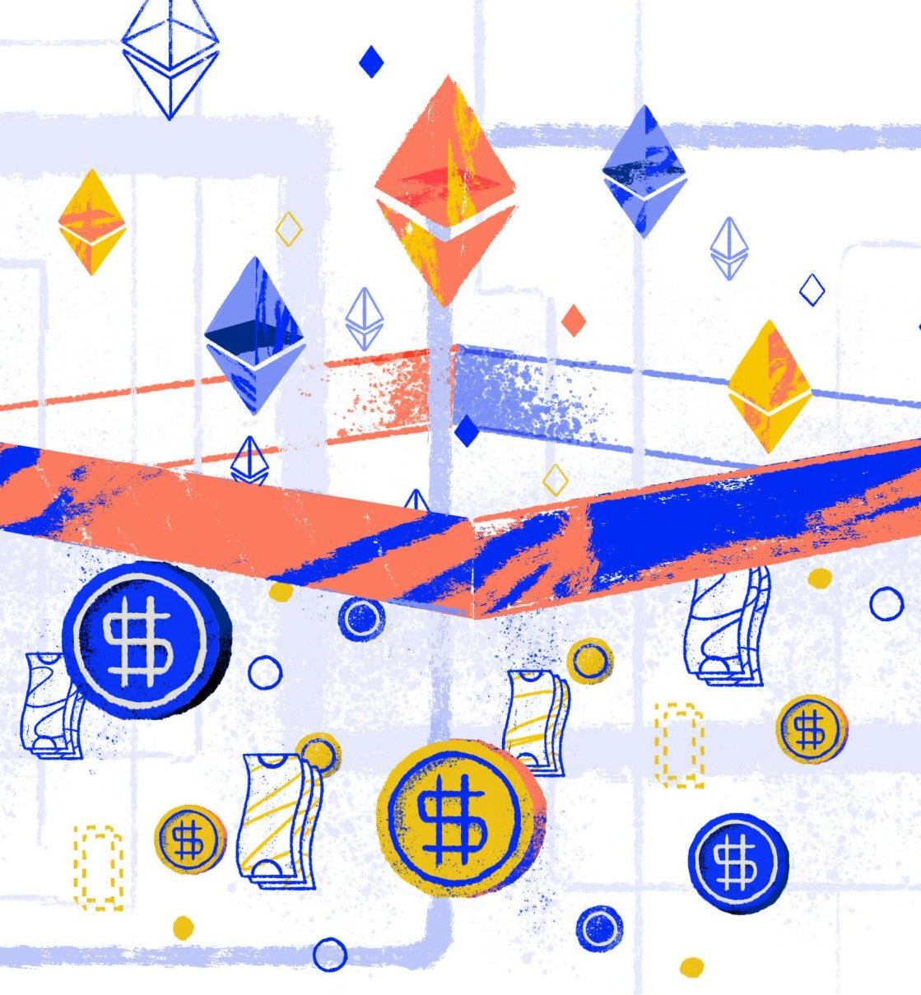
Miami Token Exchange
The Miami Token can be exchanged with any other token or coin on the Ethereum network.

Slide 17
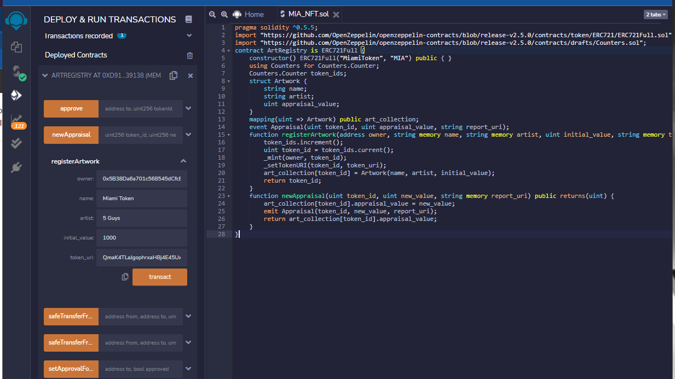
Miami Token NFT
QmaK4TLaJgophrxaHBj4E45Ux5G2usgbdnSBWFmQuGqTzG

Slide 18
QmaK4TLaJgophrxaHBj4E45Ux5G2usgbdnSBWFmQuGqTzG MIAMI TOKEN

